Slide 1
Studying Science and Innovation
Data
Gavin Reddick
25 October 2021

Slide 2
Contents
Who am I?
What is Researchfish
Why collect information on research?
How can the information be used?
What information can be leveraged?
Description of sources of funding information

Slide 3
Who am I? What is my Background?
Gavin Reddick
Quantitative Behaviouralist
Senior Information Analyst at UK Medical Research Council – Evaluation
Chief Analyst at Researchfish

Slide 4
What is Researchfish?
Researchfish is an online platform designed to make it easier for researchers to report to report the outputs, outcomes and impacts of their research.

Slide 5
Why ask for information?
Advocacy for research funding
Accountability to the funders of research
Analysis to understand what works in research and leads to impact
Allocation of future research funding
‘If I was a philanthropist giving millions of pounds, I would want to see what is happening with it – and even I get frustrated [about reporting], as a researcher, when you see millions of pounds going to researchers and you wonder what is coming out of it, and you see nothing coming out of it ... And this is always the case. In a lot of things money is given, and no one follows up … Gone are the days when you can do what you like. Now you are publicly funded … we want to account for what you are doing ... is it leading to some benefit to the public?...’ PI Quote - Researchfish: A Forward Look, p 20

Slide 6
Traditional Evaluation/Reporting?
Traditionally Impact Evaluation normally gathered information on the outcomes generated via Final Reports
Large documents containing write up of project
Reports completed immediately post funding but some outputs/impacts take time to become realised
Detailed reports in free text produced by PI but systematic analysis problematic – can use text mining techniques but even then “key” information is often missing

Slide 7
Analytical Rigour
Funders of research are often very rigorous about the research that they fund but it can be a challenge to apply the same level of rigour to the funding process itself.
Importance of the “4 As” has driven the demand to evidence claims about the efficacy of funding.
Research/generation of knowledge is a complex social phenomenon.
Data ≠ Analysis ≠ Evaluation

Slide 8
Why is Interconnectedness Important?
Reduces the need to ask people for more information – data can be understood from the linkages
Increases the consistency and quality of the information supplied if it has been externally validated instead of simply reported
Allows for more sophisticated understanding of the data and what it might mean

Slide 10
Funder
PI
RO
Award
Policy Influence
Notes:
Policy Influence 5a954bb73d33d7.45295903 – 4 funders, 3 RF UIDs, 3 Ros, 16 Awards, 1 Policy Influence

Slide 11
Publications | Intellectual Property
Collaborations | Medical Products
Further Funding | Artistic and Creative Products
Next Destination | Software and Technical Products
Engagement Activities | Spin Outs
Influence on Policy | Awards and Recognition
Research Tools and Methods | Use of Facilities
Research Databases and Models | Other Outputs

Slide 12
Publications | Intellectual Property
Collaborations | Medical Products
Further Funding | Artistic and Creative Products
Next Destination | Software and Technical Products
Engagement Activities | Spin Outs
Influence on Policy | Awards and Recognition
Research Tools and Methods | Use of Facilities
Research Databases and Models | Other Outputs

Slide 13
Research Funding Data
Today there is no single source containing “good” information on research funding.
There are a number of global initiatives seeking to improve the available information on research funding, most notably Crossref, but the nature of funding data poses greater challenge than e.g. publications.
Publications are public but information on even publicly funded research is not without controversy (funding in different areas, etc.)
Funding organisations are generally not in the habit of thinking about funding data as “of external interest” as opposed to internal files – data management.

Slide 14
Gateway to Research
Information on UK Research and Innovation funded awards
100,000+ awards and 1.6 million outputs
Mainly 2006-present day
https://gtr.ukri.org/
Information available via API – GTR2
Excellent data but limited in coverage to relatively few (though important) funders.
Data model used makes it difficult to understand lateral connections via outputs (too many “unique” identifiers for one thing)

Slide 15
Federal Reporter
Information on US federally funded awards
1,00,000+ “FY awards” and 1.6 million outputs
Mainly 2006-present day
https://federalreporter.nih.gov/
Information fractured, one award/project/program can have many records across financial years and funding streams, making it difficult to draw conclusions.
Large volume of data but difficult to use and difficult to connect outside of specific purposes for which the data is published.

Slide 16
CORDIS
Information on European Commission funded awards
1984-present day
https://cordis.europa.eu/
Information available via API but only partially – most award information available via spreadsheets.
Non-unique acronyms are the main way used to refer to these projects which can make it difficult to use to link data externally.

Slide 17
Combining data from multiple sources
Importance of understanding the schema of the data
Importance of understanding the flows of the data
Importance of “soaking and poking” the data

Slide 18
EuropePMC
Information on health relevant funded awards
29 funders (mainly UK based)
https://europepmc.org/grantfinder
Information available via API.
Tries to join together funder validated award details and publications.
Contains space for PI ORCID but low population.

Slide 19
OpenAire
Information on funded awards, mainly European, though also US, Australia
29 funders (mainly UK based)
https://www.openaire.eu/
Information available via API.
Information does not include funded amounts.

Slide 20
ORCID
International non-profit initiative
Goal to create unique, persistent identifier of people
https://orcid.org/
Information available via API.
Some challenges in “multi-unique”
Some challenges in data quality of “works” linked to people.

Slide 21
Projects using data

Slide 22
Therapies and Identified Patents
756 Cited Patents
1,999 Inventors/Applicants
26 References
16 Publications
11 Patents
50 Non ID Publications
3,435 Combined People
61 Authors
354 Publications
1,375 Authors
Notes:
Active Awards – R1,2,4,5 with active PI

Slide 23
Grantee Matching
2,142 Grant-PI Combinations
3,435 Combined People
1,241 Last Name Matches
16 Matches
3 Maybes
1 Prior Fund Matches
1 Prior Fund Maybe
3,277 Last Name Matches
0 Matches
Fuzzy Match Additive
Notes:
Active Awards – R1,2,4,5 with active PI

Slide 25
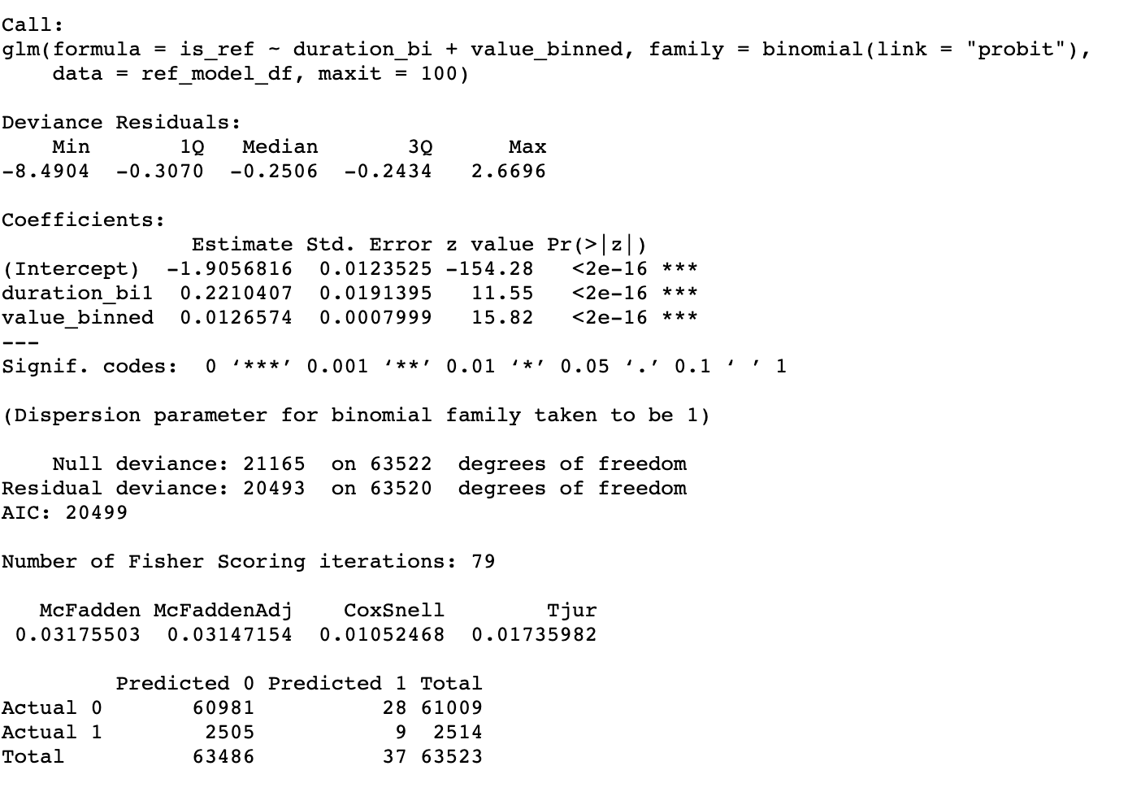
Basic model: duration and funding value
Independent variables:
Duration (4 Binary)
Funding value (Bins of 100k)

Slide 26
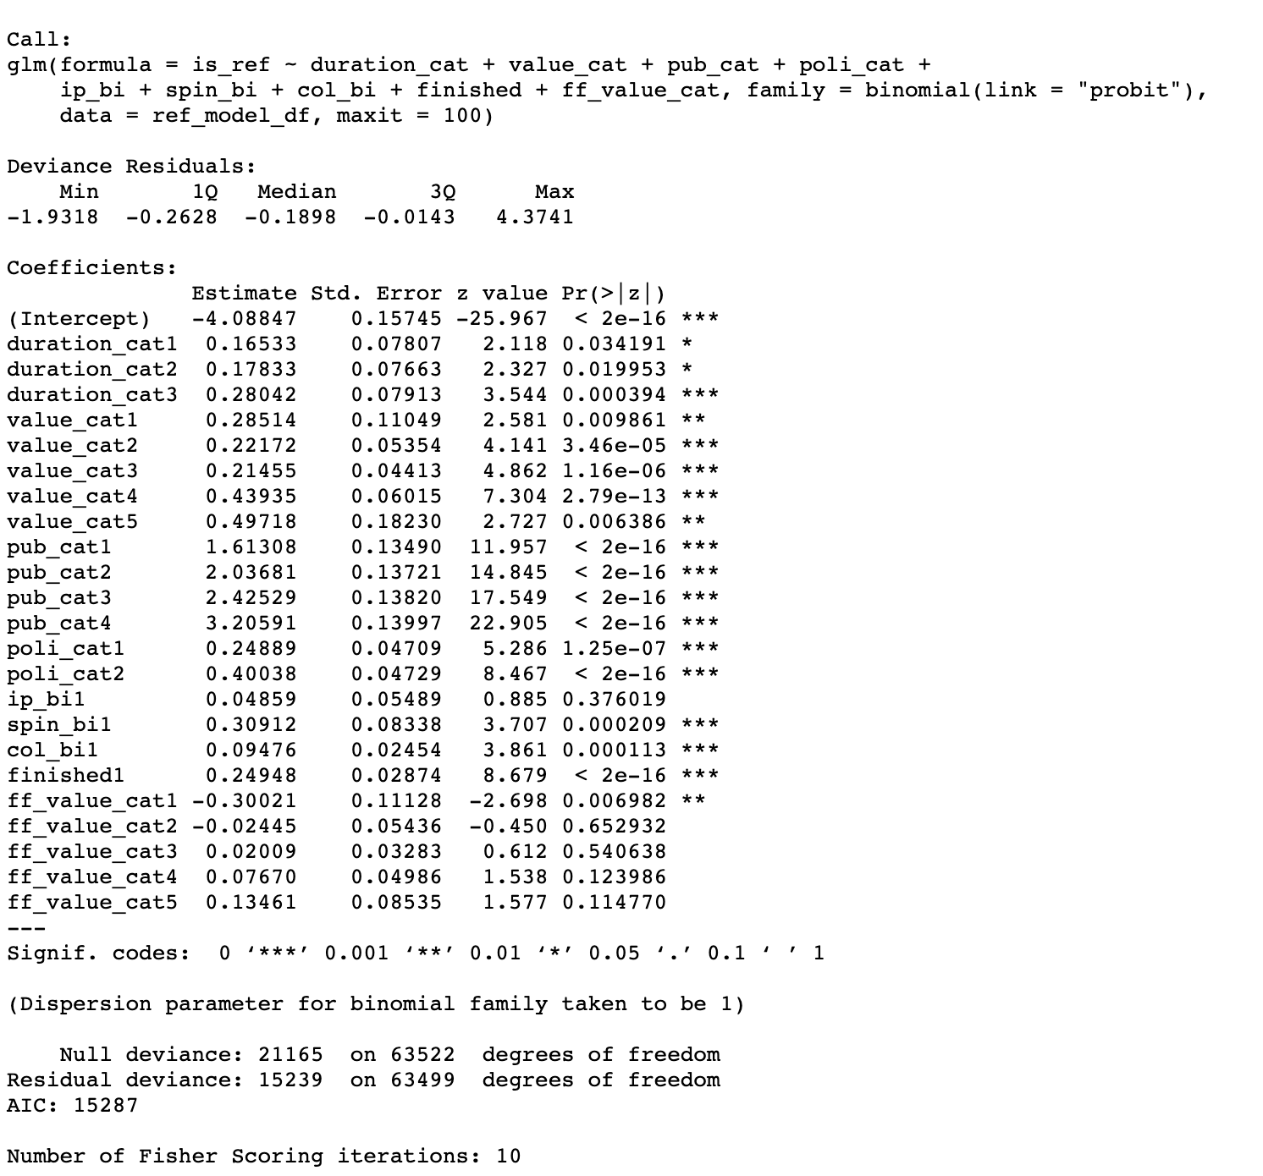
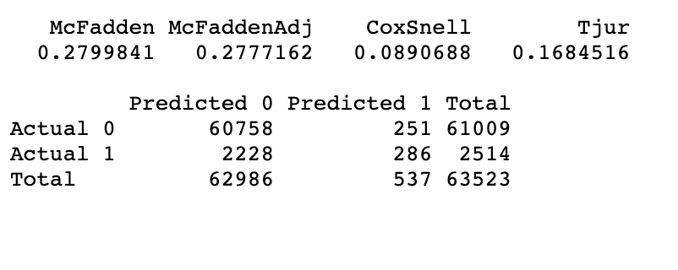
Advanced model: 9 predictors
Independent variables:
Duration (4 categories)
Funding value(6 categories)
3) Number of publications (5 categories)
Number of policy influences (3 categories)
Number of IP registrations (Binary)
Number of spinouts (Binary)
Number of collaborations (Binary)
Finished or not (Binary)
Further funding value (6 categories)
c

Slide 27
Predicted probabilities

Slide 28
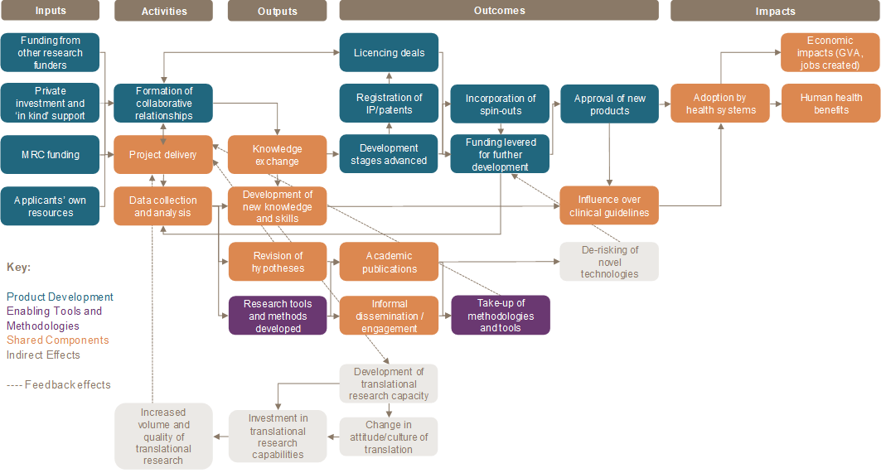
Logical framework for evaluation
To guide the evaluation, a theory of change was developed, which set out the full set of expected causal processes from MRC funded research to eventual impact that might be seen across the whole portfolio, while recognising that within single funding schemes a smaller set of pathways and processes might be relevant
This framework highlighted likely differences in emphasis between the focused and enabling mechanisms within the directed translational portfolio.
Source: Ipsos MORI and Technopolis
Example of Logic Model taken from Ian Viney – Bridging the Gap: 10 Years of MRC Translational Research, 2020-02-24

Slide 29
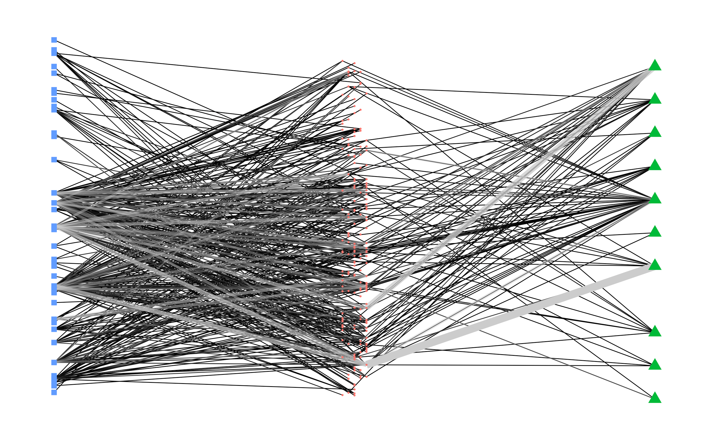
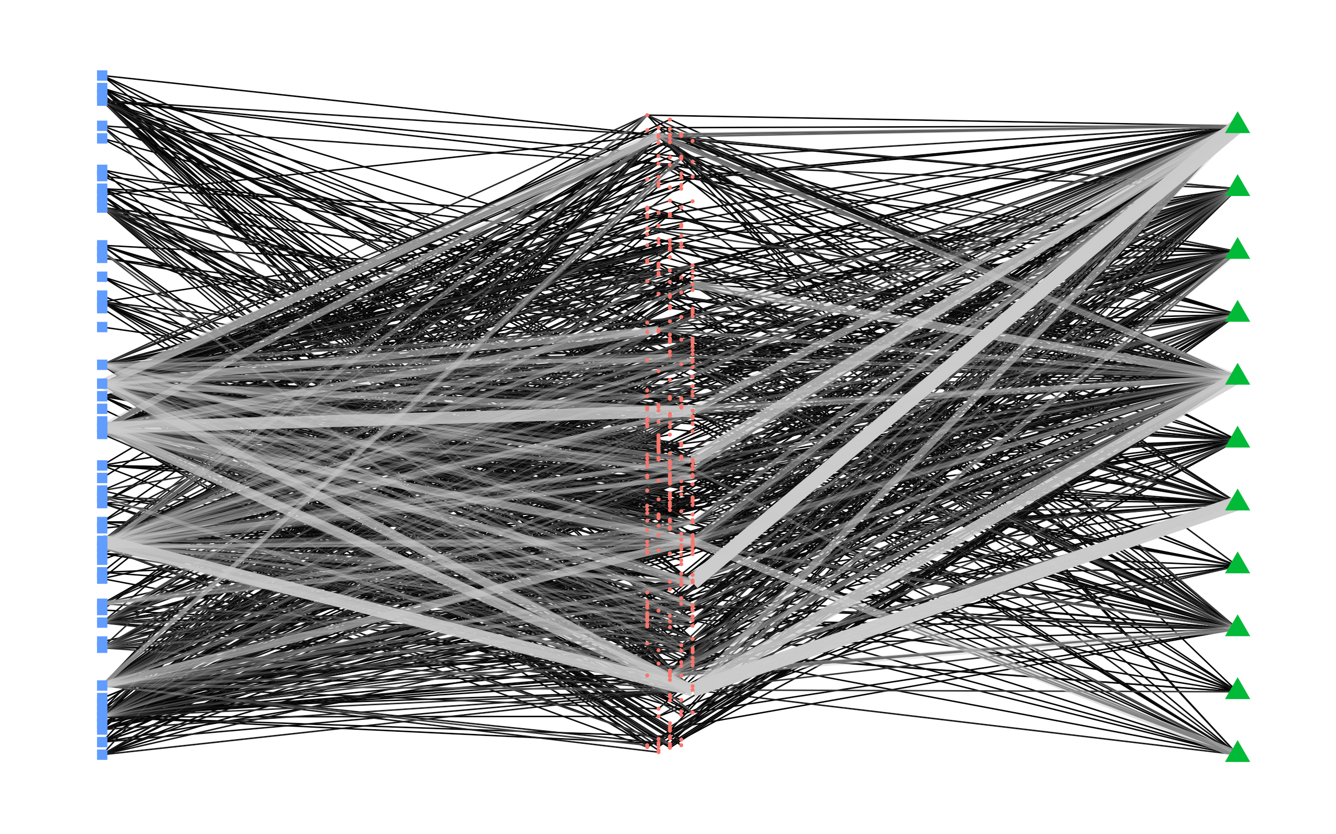
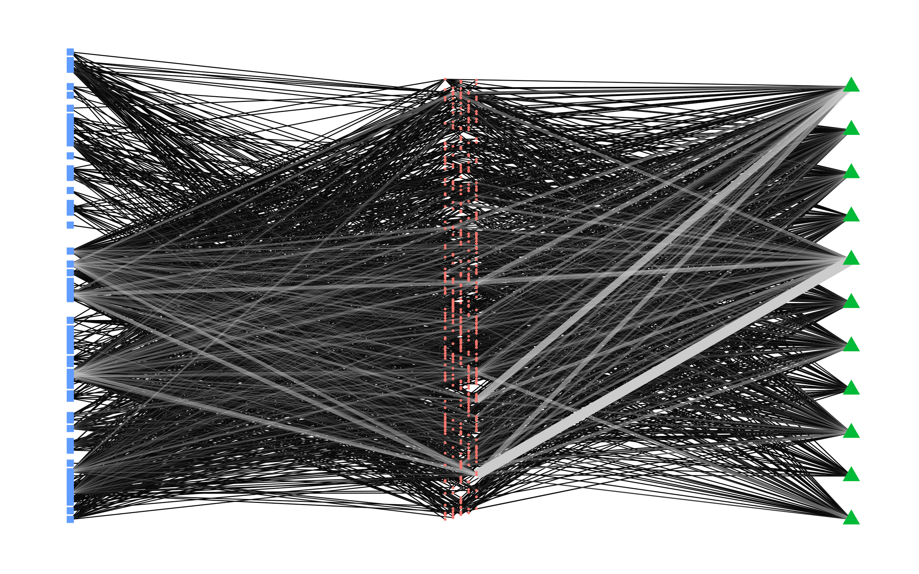
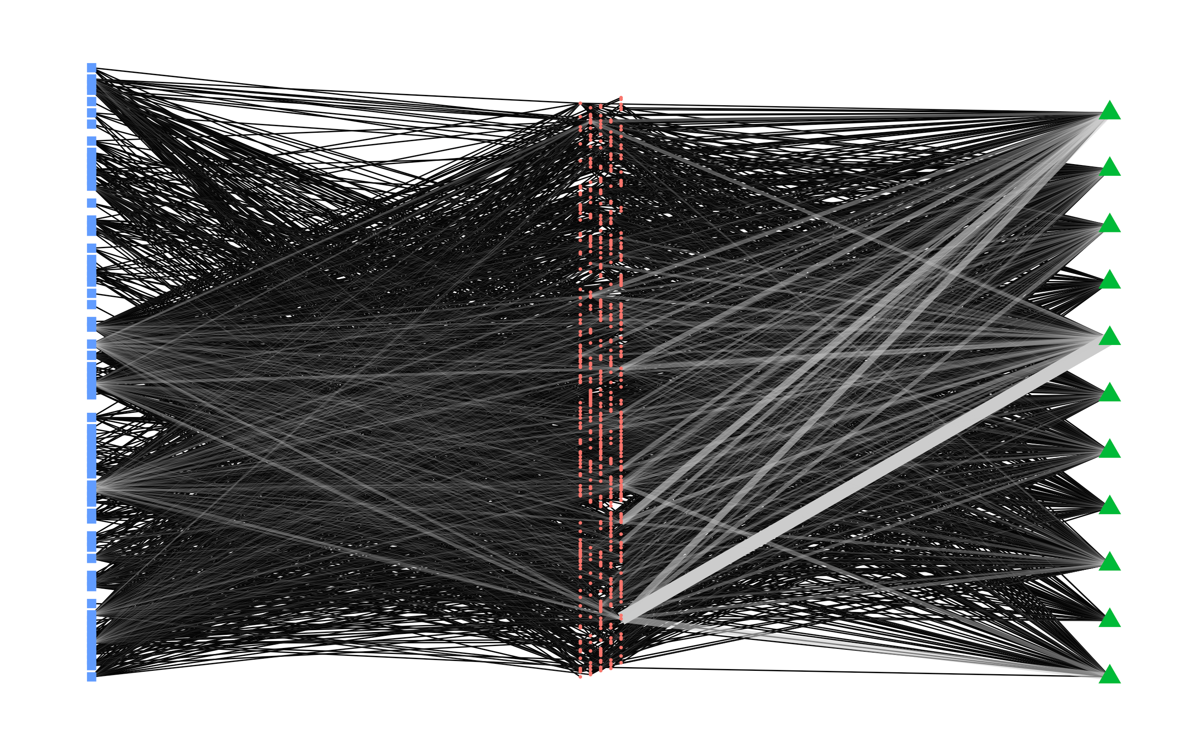
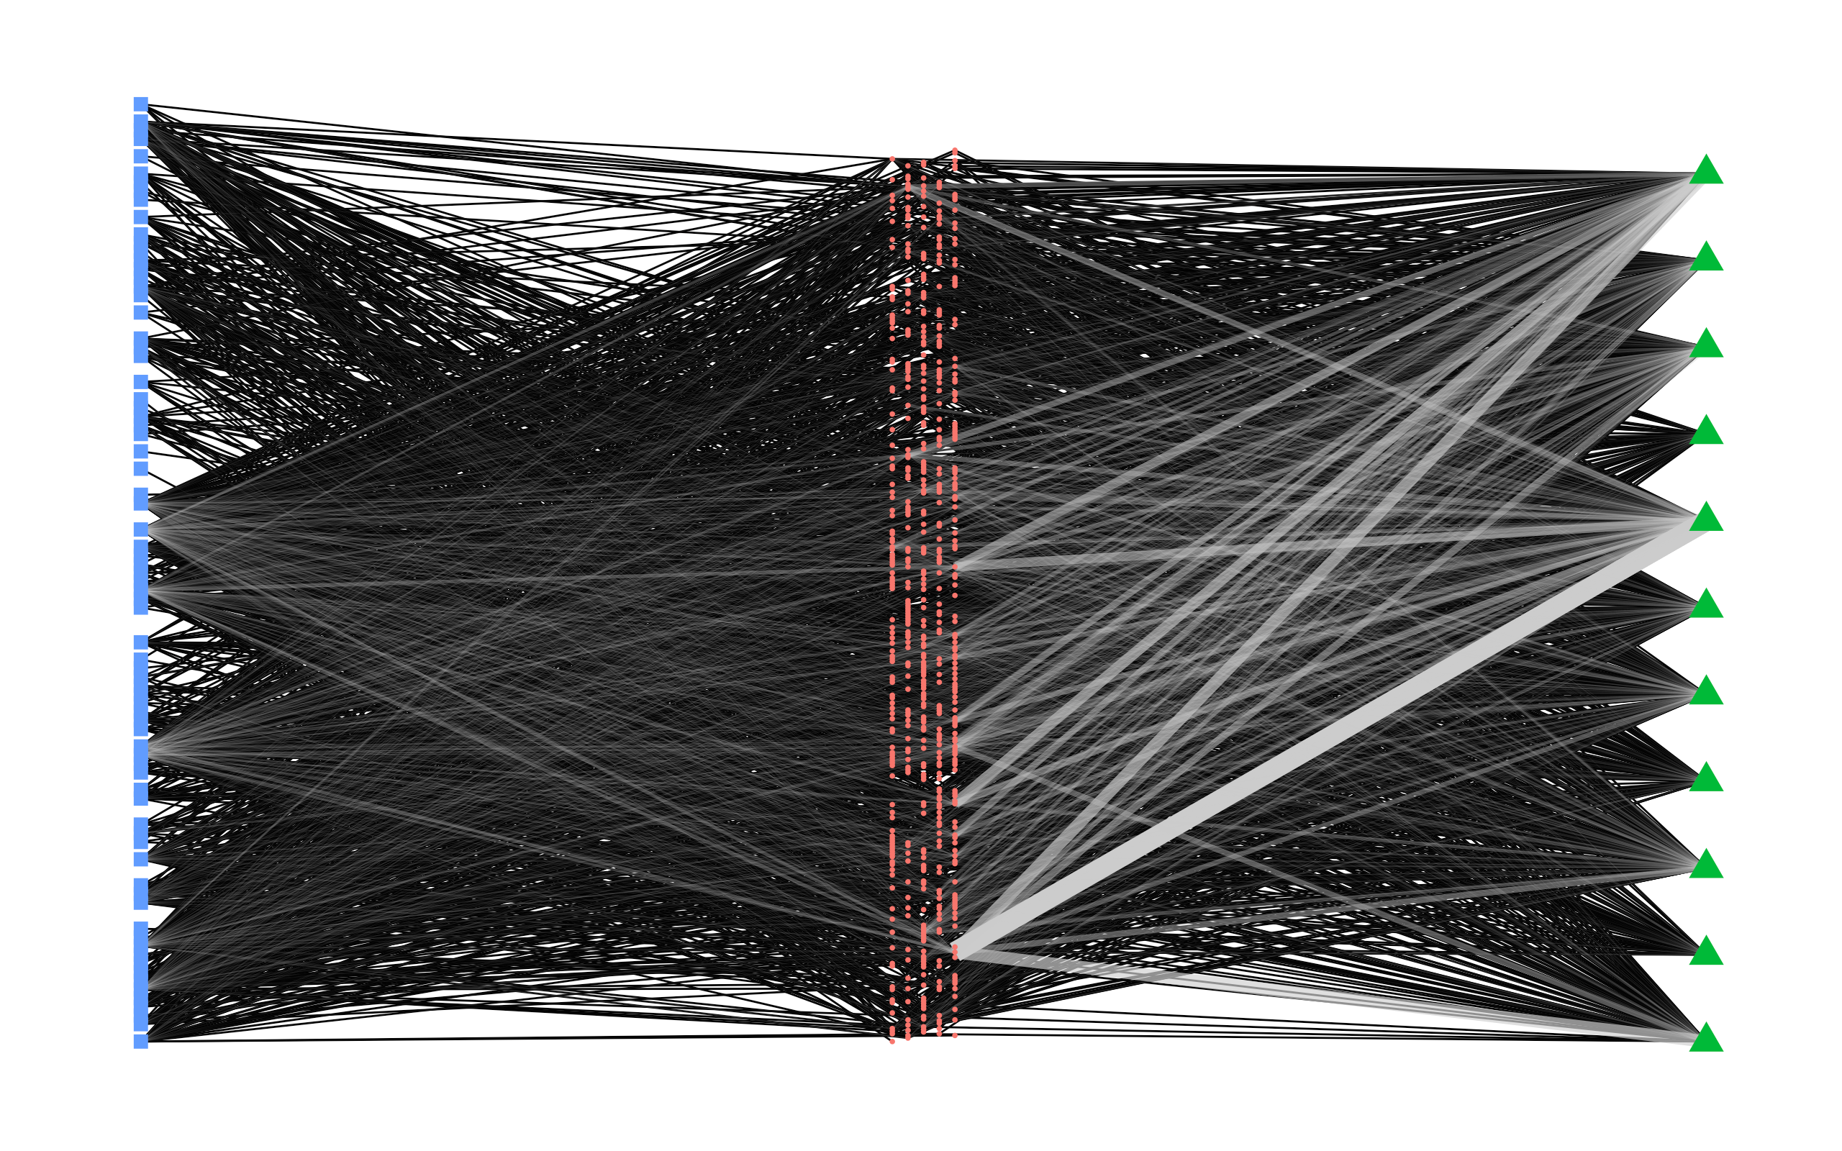
N2. Behaviors over time
2010
2012
2014
2016
2018
2020

Slide 30
Questions?
Contact:
Gavin.Reddick@interfolio.com

